Slide 1


ASIAN PEST CONTROL

Slide 2
asian PEST CONTROL
(Public health & agriculture)
Mission Statement:
Our ultimate goal is to be recognized as the best “Pest Control” service company in our industry. Our mission is to protect you, your family and your valuable assets with highly trained pest management professionals. Our primary concern will be safety and care of all personnel and the environment during the execution of our tasks. To be a leading provider of top quality pest control service by offering professionally managed pest control technicians.
Vision:
To make quality pest control services available to all, operating with reliability, effectiveness, customer-orientation and great value for money through science and technology. Asian Pest control will be the leading pest control business with the highest level of customer service and professionalism by 2020.

Slide 3
PROFILE OF
ASIAN PEST CONTROL
OFFICE ADDRESS:
Room # 510 (4th Floor), Ibrahim Mansion,
11, Purana Paltan, Dhaka-1000.
Cell: 01720- 530844, 01919-530844, 01970-530844
E-mail: reazakter78@gmail.com, asianpestcontrolbd@gmail.com

Slide 4


Slide 5
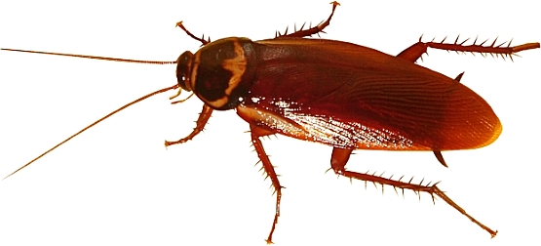
Cockroach control by spraying & Gel treatment of Hotel, House, Office & Restaurant etc.

Slide 6

Rodent control by Glue board, Snap trap & Bromodialin position at house, office, factory, restaurant, hotel etc.

Slide 7
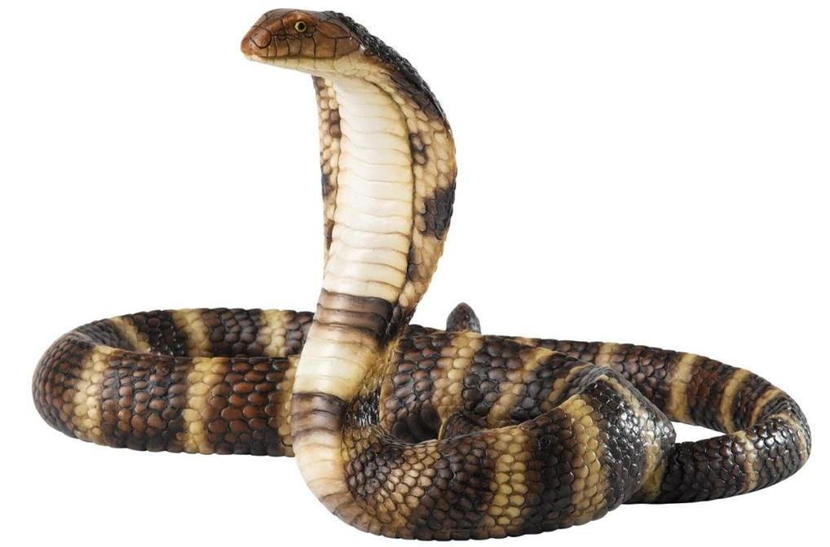
Snake repellant by Acid & powder chemical treatment at out side of Hotel, House, Office Factory etc.

Slide 8
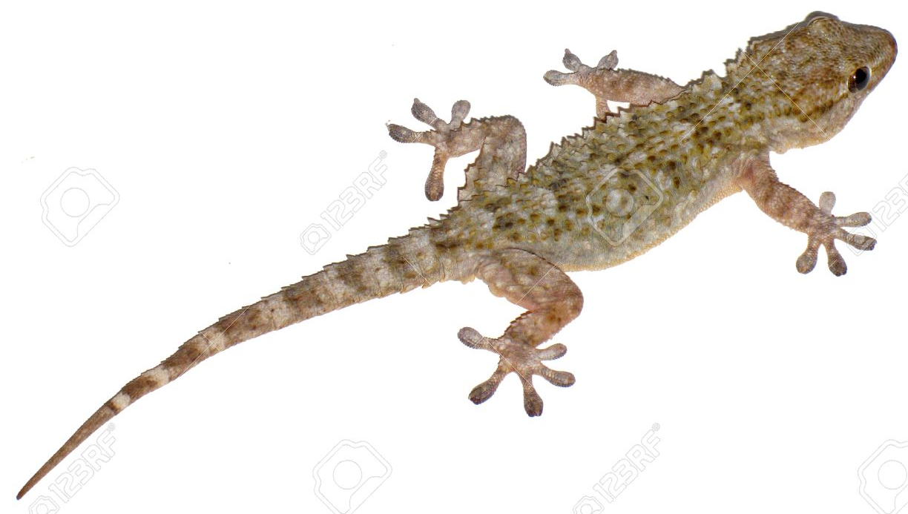
Lizard control by – spraying & Glue treatment at House, Hotel, Restaurant, Kitchen etc.

Slide 9
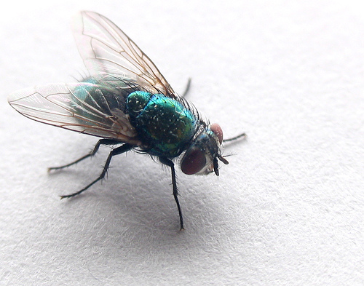
Flies control by Bait placement & Trapping.

Slide 10
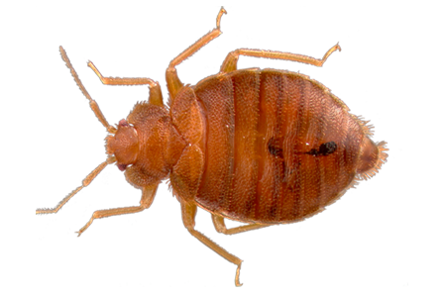
Bed bug control by spraying & Hot moisture at Train, Ship, Hotel, Motel, House etc.

Slide 11
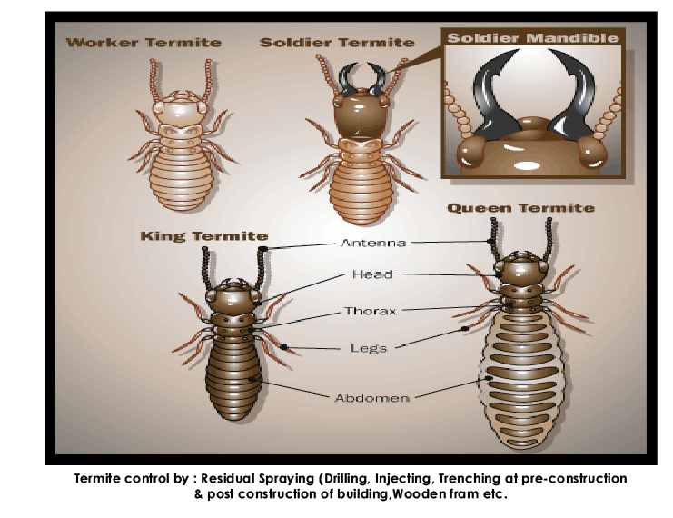
Termite control by: Residual Spraying (Drilling, Injection, Trenching at pre-construction & post construction of building, wooden frame etc.

Slide 12

Adult Mosquitoes Control by Fogging at out side of Hotel, House, Garden etc.

Slide 13
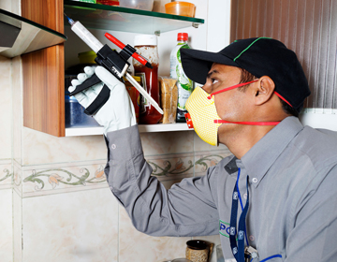

Gel Placement for Cockroaches at Hotel, House, Factories etc.

Slide 14
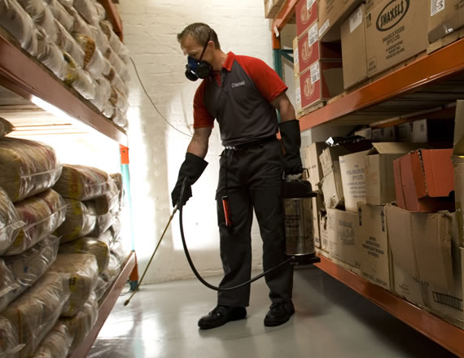

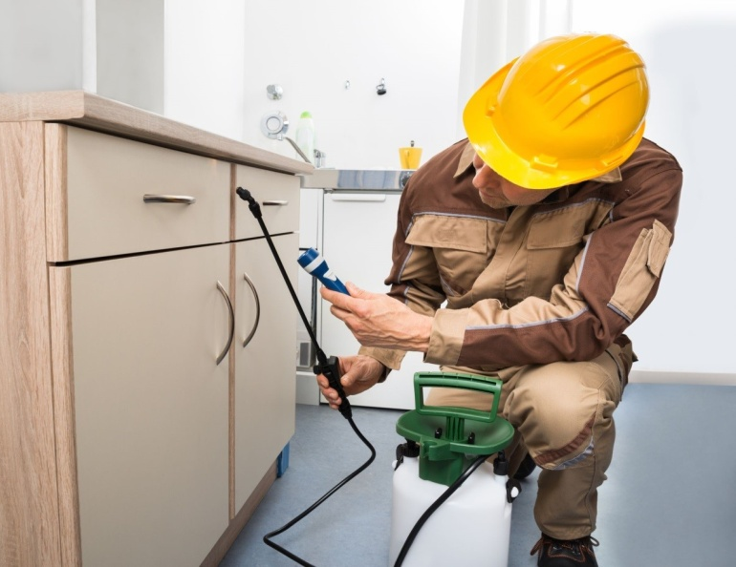
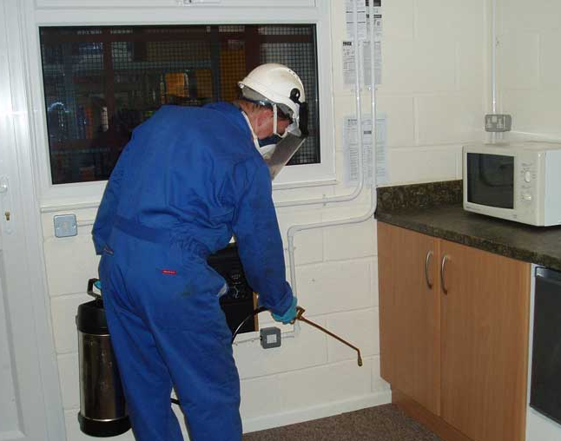
Residual Spraying at Warehouse, out side and inside of Hotel & Houses.

Slide 15
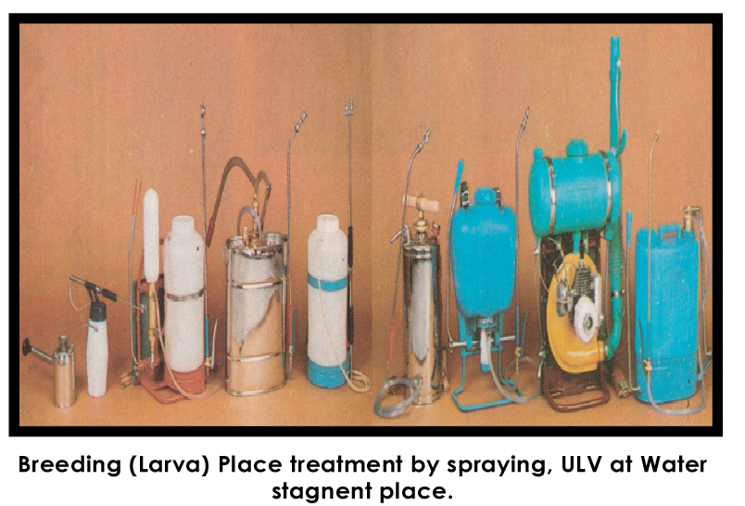

Slide 16
HONORED CLIENT LIST OF
ASIAN PEST CONTROL
01. Ceylon Biscuits Ltd.
02. Crossline Bangladesh.
03. Cross Prod Bangladesh Ltd.
04. Secret Recipe.

